Slide 1
Getting Started with Webots
Modern Control - Theory and Design

Slide 2

Installing Webots
https://www.cyberbotics.com/
Download and install for your OS according to the instructions provided in the pdf.
If you need help with installation, see the Webots guide at:
https://www.cyberbotics.com/doc/guide/installation-procedure

Slide 3
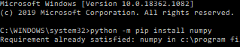
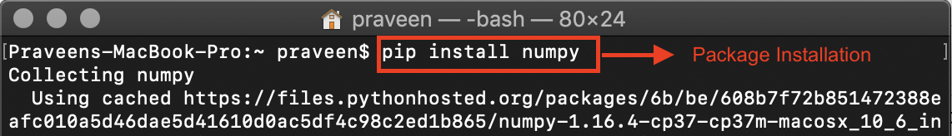
Set Up Python
Webots looks for a native Python installation, so distributions like Anaconda will not work
Please install a separate version of Python for this project (3.7 or 3.8, not 3.9) from https://www.python.org/ if necessary
You will have to reinstall necessary packages via pip:
numpy
scipy
matplotlib
Image source:
https://www.edureka.co/blog/install-numpy/

Slide 4
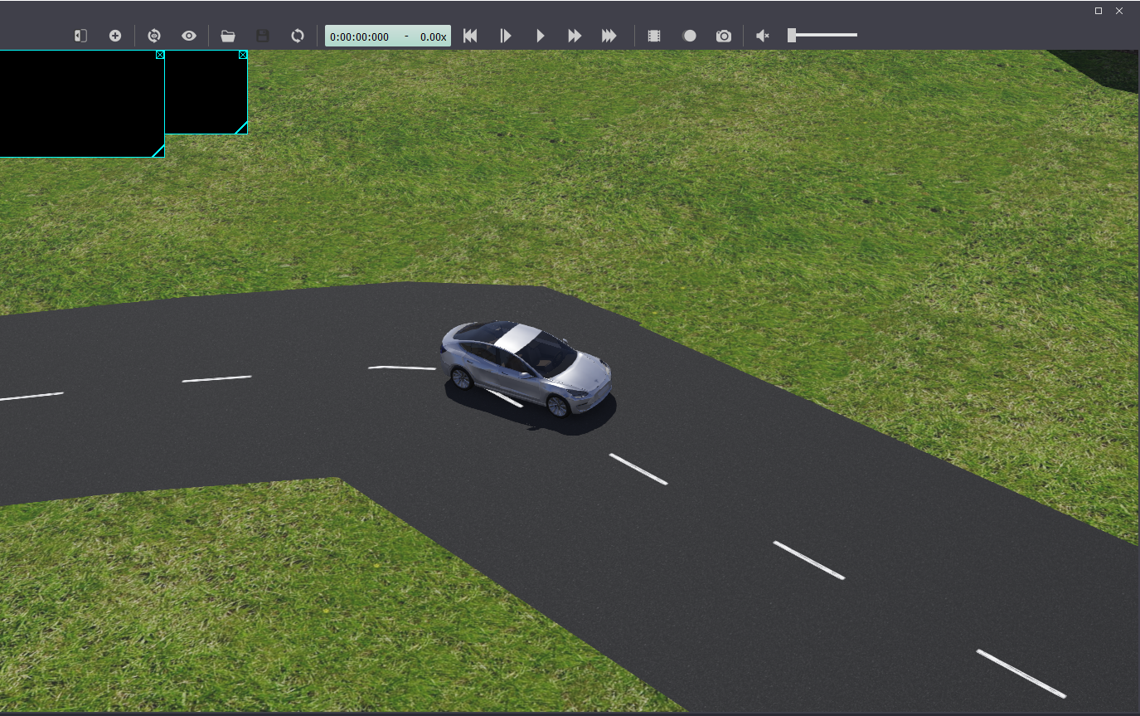
Opening the Project File
You can access the project files via Canvas. We’ll be using the folder named “Code”.
Download/unzip the “Code” file
Open Webots and go to File > Open World
Open Code > worlds > automotive_new.wbt
The center of your Webots application should look like the image on the right

Slide 5
Interacting with the Simulation
Elapsed
time
Real-time multiplier
Start simulation
Disable visualization and start
Open world file
Advance one timestep
Start simulation in real-time
Reset simulation

Slide 6
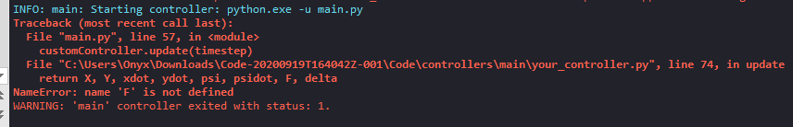
Running the Simulation
Go ahead and start the simulation in real-time by pressing the play button. You should get the following error printed to the console at the bottom:
You’ll also see that the elapsed time and real-time multiplier have changed:
Stop the simulation (pause) and reset (rewind).

Slide 7
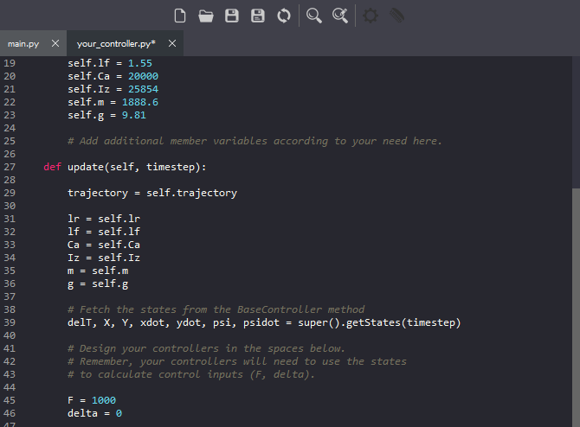
Controlling the Car - Pt. 1
Open Code > controllers > main > your_controller.py in the editor of your choice
Webots has its own barebones editor, which can be toggled with Tools > Text Editor
Add code to the update method in the CustomController class
For starters, add two simple lines that assign F and delta, our control inputs:
F = 1000
delta = 0

Slide 8
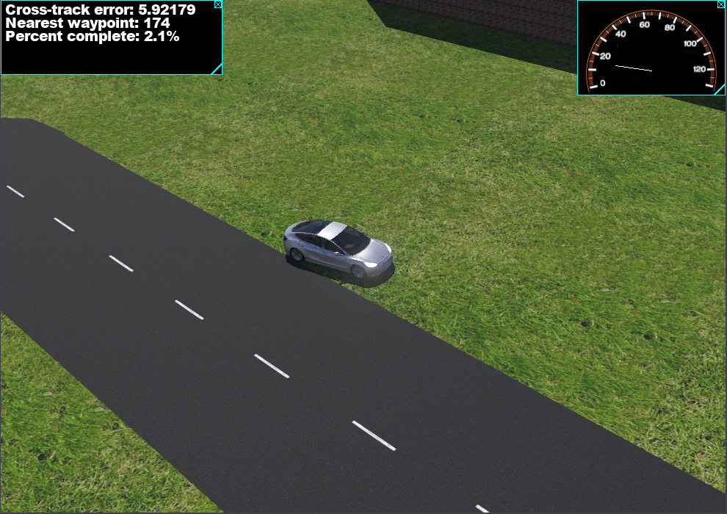
Controlling the Car - Pt. 2
4. Save the your_controller.py file
5. Start the simulation in real-time (play)
6. The car should start to move!
7. The two displays in the center window (speedometer and console) will update
8. When you’re ready, stop the simulation (pause) and reset (rewind)

Slide 9
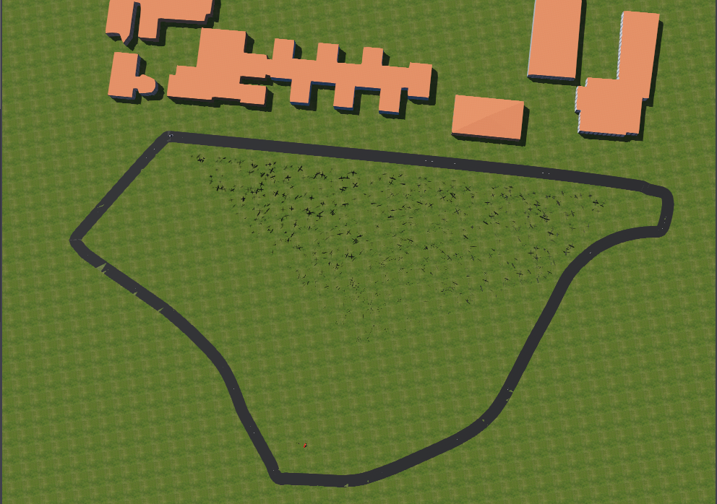
Project Overview
Goal: implement lateral and longitudinal controllers that allow the car to finish the course
Once you reach the finish, your performance will be evaluated, and your grade printed to the bottom console
In addition, a plot of your performance and the vehicle states will be generated by matplotlib
Submit your_controller.py and the plot in a PDF file to Gradescope

Slide 10
Important Notes
Please make sure to carefully read the project documentation and ask us if you have any questions!
Webots documentation will be a big help, too! I recommend you complete at least the User Guide’s Tutorial 1: https://www.cyberbotics.com/doc/guide/tutorial-1-your-first-simulation-in-webots

Slide 11
Any Questions?
Please let us (the TAs) know if you have any issues in setting up Webots/Python that you are unable to resolve.
Windows: Vaibhav Shete, Varun Bhatia, Huaiqian Shou
MacOS: Peide Huang
Ubuntu: Jiayin Xia
Good luck!

